Slide 1
Peer-Graded Assignment: Capstone Project - The Battle of Neighborhoods (Presentation)
Greek Restaurant in New York city
By
Sotiris Papanikolaou

Slide 2
Introduction / business problem
In the project we presented a guide on how to choose the best location in New York City to open a Greek Restaurant.
The choice took into account the number of Greek restaurants (positive indicator) and the number of general type restaurants (negative indicator) in each New York City neighborhood.
For example if there exists a neighborhood where one out of ten restaurants are Greek then people in this area seem to be very interested in Greek food and may be a good place to open a business.
This presentation contains very useful information and accurate results .

Slide 3
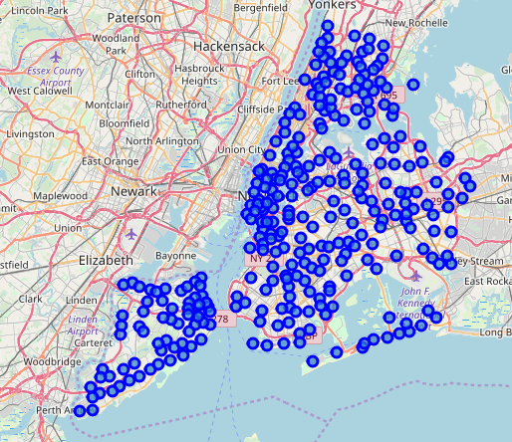
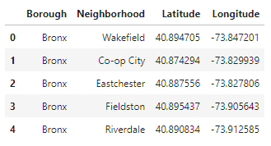
Data
The data used for this project was New York neighborhoods data and FourSquare data. After downloading, importing and wrangling and visualizing the data we present its final form.
Neighborhoods data sample:

Slide 4
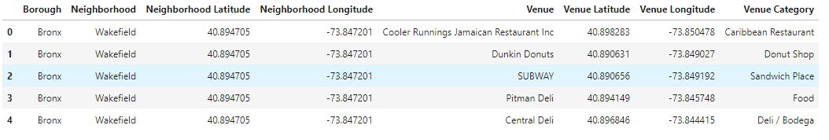
Data
FourSquare data sample:
Greek type of restaurants are also contained in this dataframe.

Slide 5
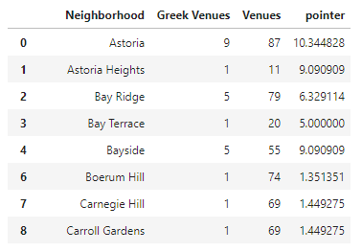
Data Analysis
We create for each neighborhood a number (pointer) which represents the suitability of this neighborhood to host a Greek restaurant.
This number is the quotient of Greek type restaurants and general type restaurants in the neighborhood, multiplied by 100 (or the percentage of Greek restaurants versus general type restaurants in the neighborhood).
We can see the results below :

Slide 6

Clustering
We use kmeans (machine learning tool) to cluster our neighborhoods based on the suitability to open a Greek restaurant.
We will train the model with the pointer data. We can see a resulting dataframe sample with cluster labels.
Finally in the following slide we create a map presenting the clustered neighborhoods in colors.

Slide 7
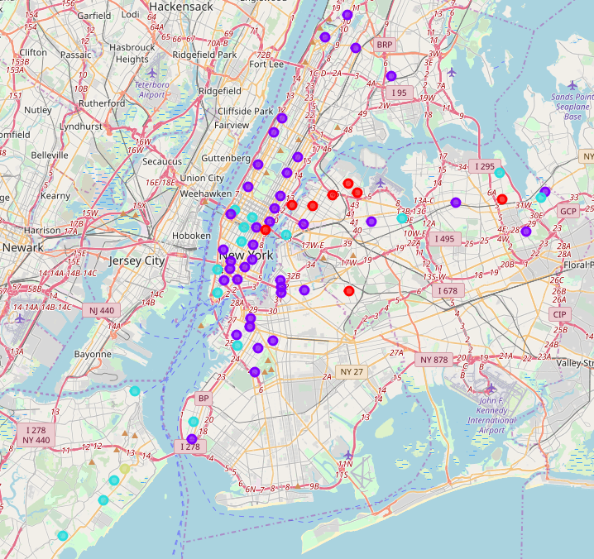

Slide 8
results
According to our model, if someone wants to open a Greek restaurant he should consider the following:
Green is by far the most suitable neighborhood (outlier).
Red are very good results.
Light blue are good results too.
Purple are not so good neighborhoods to try your luck.
Finally neighborhoods not showing in the above map are the worst choice.

Slide 9
Results
In Manhattan, Midtown and South neighborhoods are more suitable places to open a Greek restaurant but there is a lot antagonism cause there are so many types of restaurants in these neighborhoods.
We wouldn't recommend Bronx for starting a business.
In Brooklyn a good choice is Gowanus and nearby neighborhoods, but a better one is Bay Ridge.
In the Southeast part of Staten Island, Dongan Hills, Grant City, Bay Terrace and especially Old Town are very good neighborhoods to start a Greek restaurant business.
Finally Queens seems to be the most suitable Borough. There is an obvious trend in Greek restaurants in Astoria and neighborhoods near it. With a simple web search we found out that Astoria is the Greek cultured neighborhood of New York city since it was the home of the first Greek immigrants. So the most suitable neighborhoods to open a Greek restaurant in Queens and we could say in all of New York city are by far neighborhoods close to Astoria, and also Bayside, Bay Terrace and Douglaston.

